Slide 1

AI-Powered Cloud Kitchen Sales Prediction & Assistant
Data Analytics • Machine Learning • GenAI Integration
Presented by: Arushi Shivhare
PRN: 22070521062
Sem /Sec: 7A
Tools Used: Python | Pandas | Scikit-learn | Streamlit | OpenAI API

Slide 2
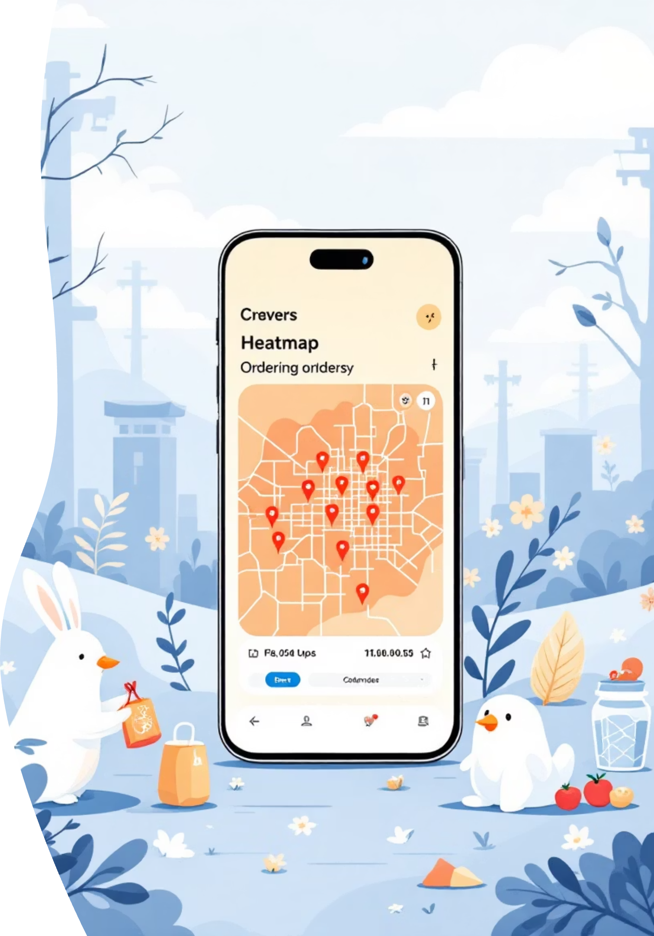
CHAPTER 1: Introduction
The Challenge: Optimizing Cloud Kitchen Operations
Cloud Kitchen Dependency
Forecasting Needs
Cloud Kitchens (or Ghost Kitchens) are delivery-only food businesses. Their entire revenue stream is dependent on efficient and reliable online order fulfillment.
Accurate daily sales forecasting is critical to optimizing inventory (reducing waste), ensuring appropriate staffing levels, and running targeted marketing campaigns.
The Solution: AI Integration
This project integrates data analytics, ML prediction, and a GenAI chatbot to provide powerful, data-driven decision support.

Slide 3

PROJECT ROADMAP
Core Objectives for the Sales Prediction System
Data Preparation
Clean and preprocess raw Point-of-Sale (POS) data for consistency and completeness.
Deep Dive Analytics (EDA)
Conduct Exploratory Data Analysis to uncover hidden patterns and trends in sales performance.
Predictive Modeling
Build, train, and rigorously evaluate an ML model for accurate daily sales forecasting.
Application Deployment
Deploy a user-friendly Streamlit web application for real-time, live prediction use.
Intelligent Assistant
Integrate a GenAI (ChatGPT-based) assistant to provide contextual business insights from the data.

Slide 4

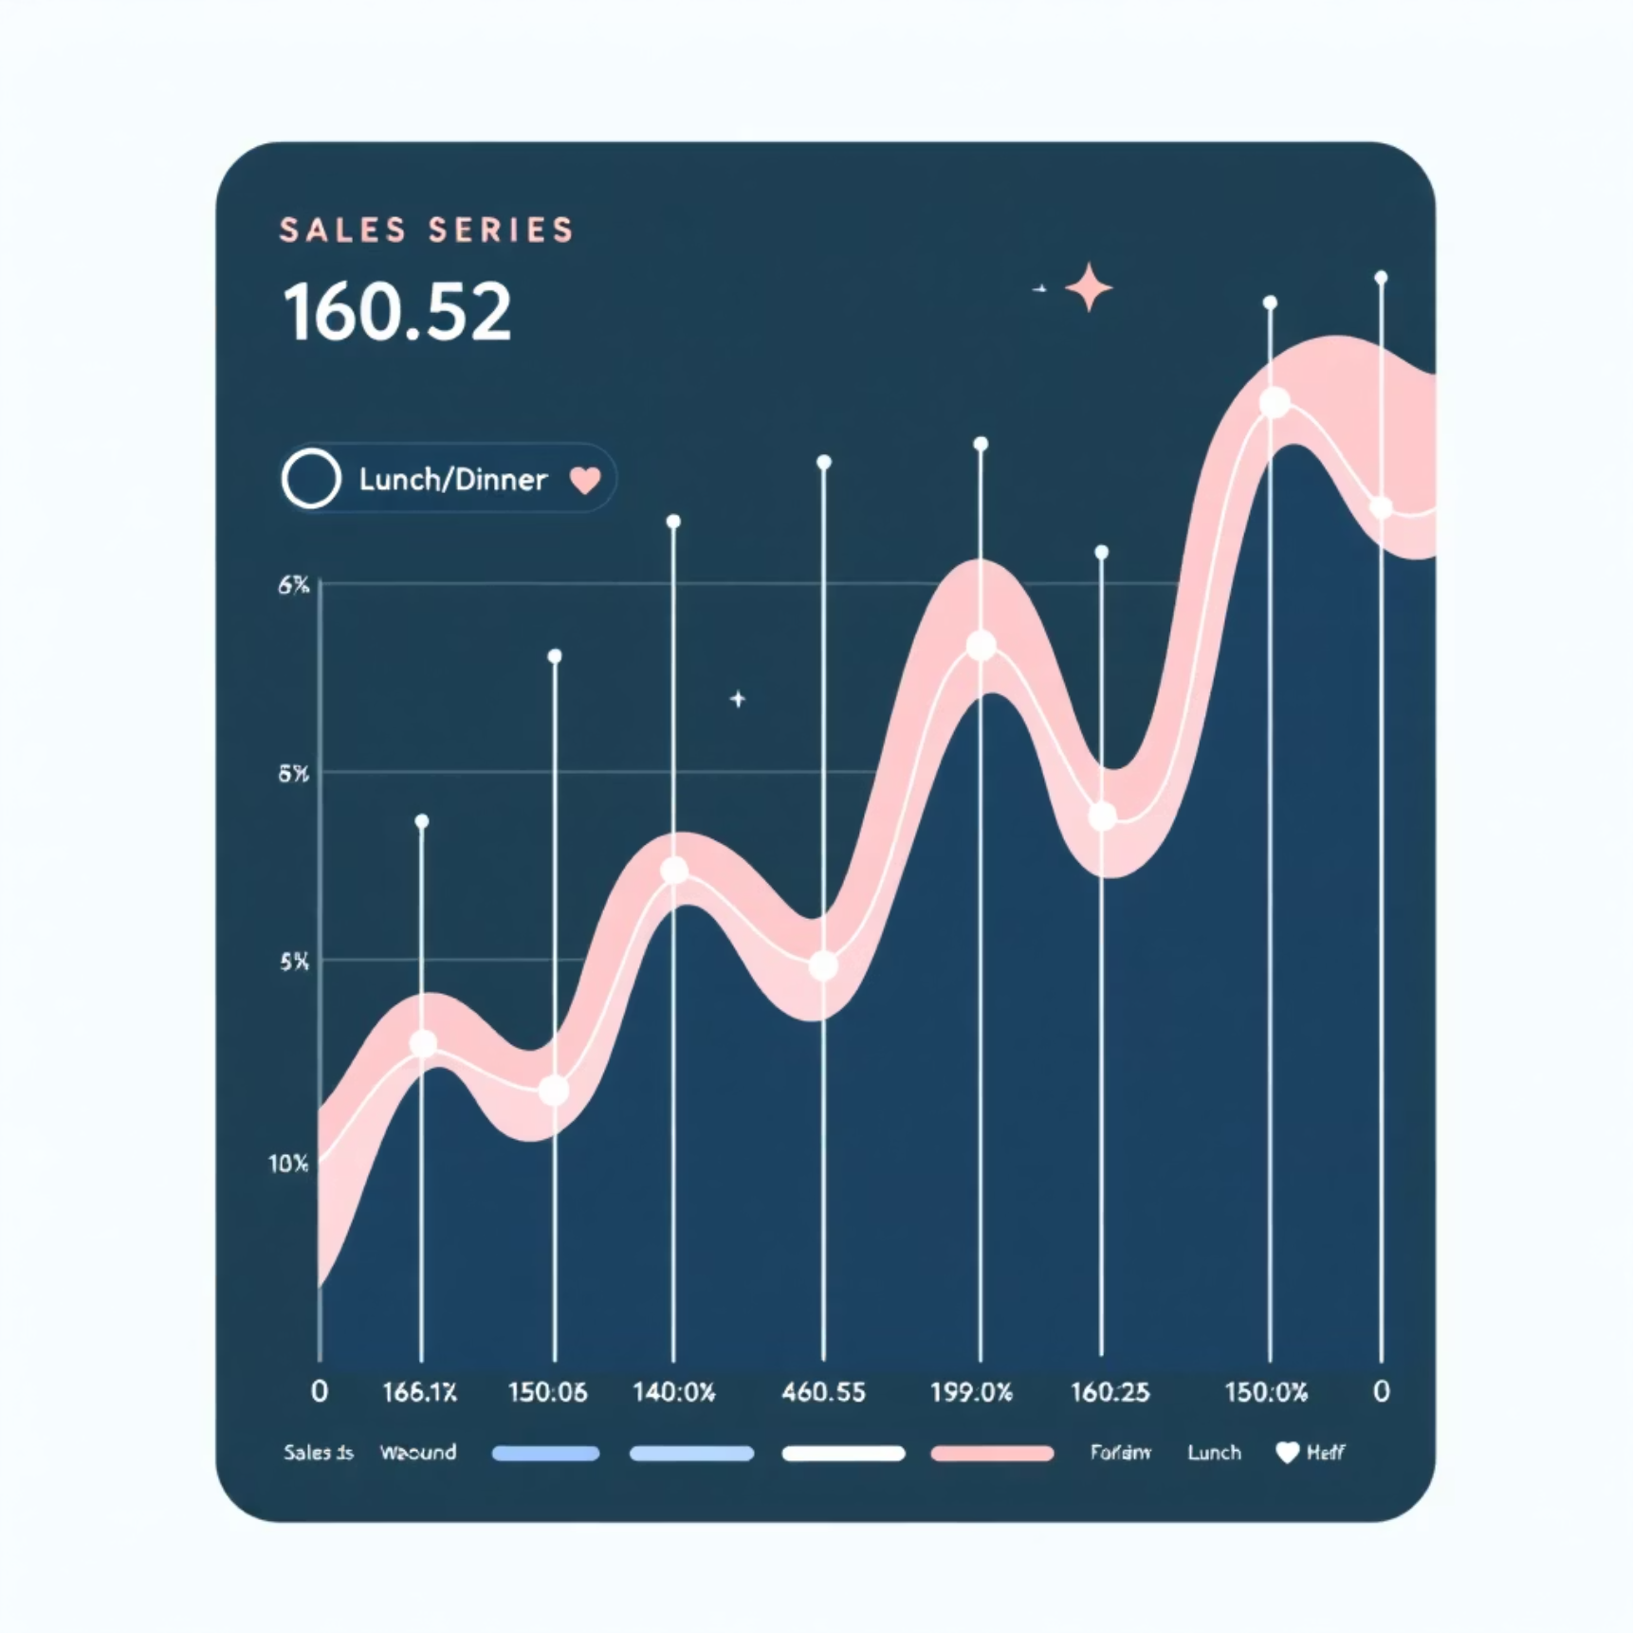
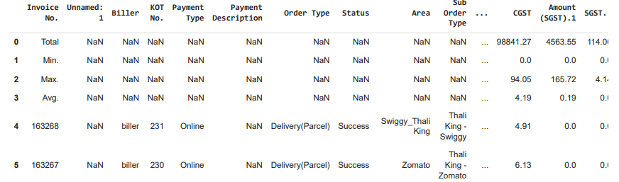
TECHNICAL STACK
Key Technologies and Resources Utilized
The project leveraged a robust suite of Python libraries for data science tasks, ensuring efficient processing, visualization, and modeling.
Data Profile
Python Libraries
Merged_Orders_Report.csv
Pandas, NumPy, Matplotlib, Seaborn, Plotly, Scikit-learn for the entire ML pipeline.
Source dataset contained over 25,000 order entries, providing a rich base for time-series forecasting.
Deployment & Interface
Model Persistence: Joblib was used to serialize the trained ML model for deployment.
Streamlit for building the interactive web application.
Generative AI
OpenAI API for integrating the ChatGPT-powered insights assistant.

Slide 5
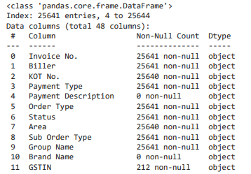
ML PIPELINE STAGE 1
Data Cleaning and Feature Engineering
Initial Cleanup
Removed non-data metadata rows and standardized column headers for uniformity.
Structural Integrity
Dropped empty columns and rows, ensuring all remaining entries were relevant and complete.
Type Conversion
Converted the 'Date' column to the datetime format and ensured numeric columns (Rate, Amount, Discount) were correctly typed.
Handling Categorical Data
Label-encoded categorical features and imputed missing values using appropriate strategies.
Result:
A robust, cleaned dataset of ~25,000 rows and 48 columns, fully prepared for Exploratory Data Analysis (EDA) and subsequent modeling.

Slide 6
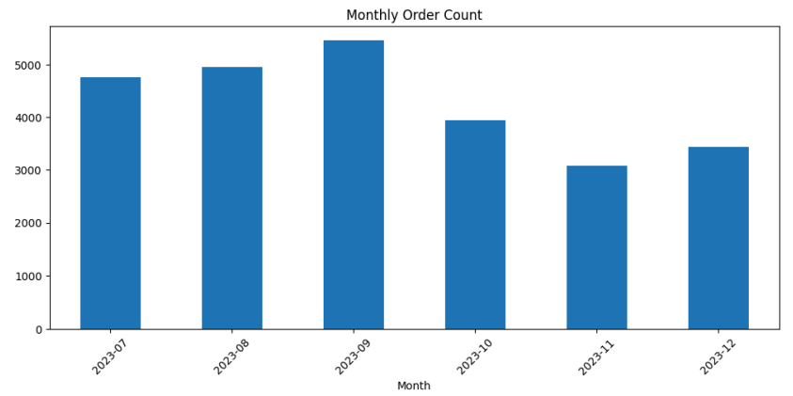
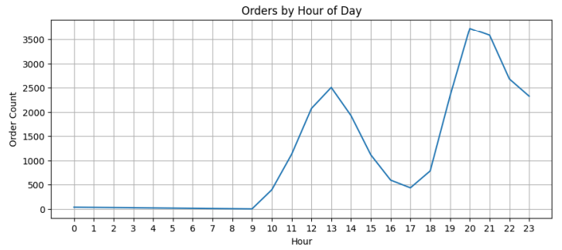
ML PIPELINE STAGE 2
Exploratory Data Analysis: Uncovering Sales Drivers
EDA was crucial in identifying key patterns and seasonality that directly influence sales predictions and operational decisions.
Monthly & Seasonal Trends
Observed clear growth trajectories and annual seasonal fluctuations in order volume.
Peak Ordering Hours
Identified high-density periods, particularly around traditional lunch and dinner rushes, informing staffing.
Day-of-Week Effect
Confirmed that weekends consistently show the highest order volume, justifying variable inventory levels.
Payment Method Insights
The vast majority of transactions utilized online payment methods, simplifying cash handling.

Slide 7

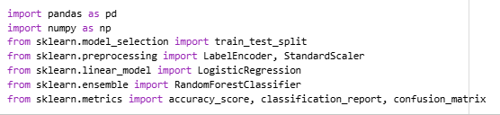
ML PIPELINE STAGE 3
Predictive Model Training and Evaluation
The data was split into an 80% training set and a 20% test set to validate generalization. The model successfully achieved reliable predictions on unseen test data, demonstrating its utility for real-world forecasting.
Target Variable
The trained pipeline was serialized and saved as model_pipeline.joblib for seamless integration into the web application.
The model was trained to predict the daily Total Sales (₹).
Algorithm
Scikit-learn's Linear Regression model was selected for its interpretability and robust performance.
Evaluation
Model performance was assessed using the Mean Squared Error (MSE).

Slide 8
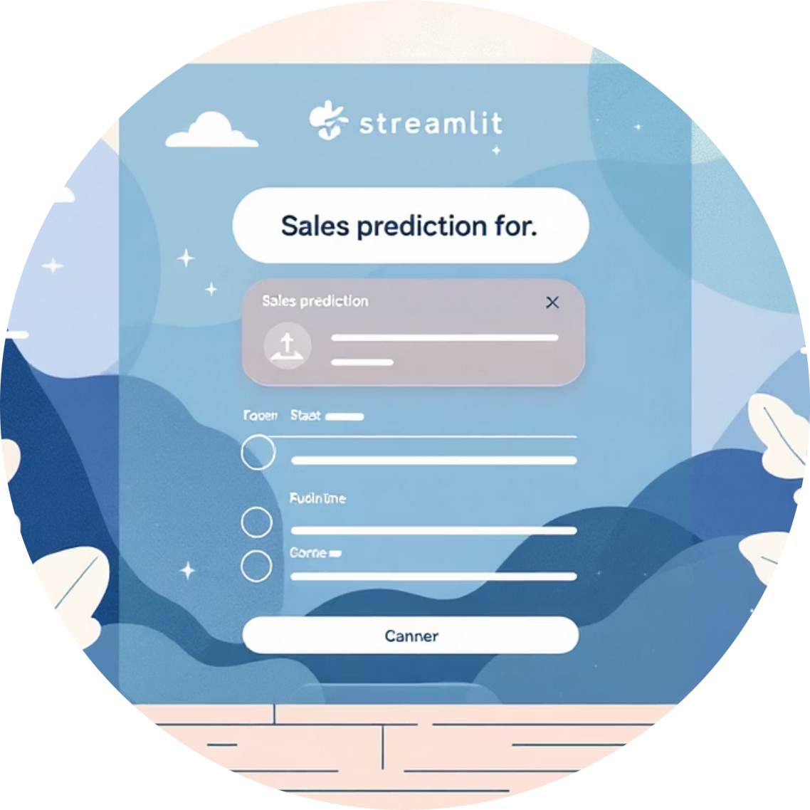
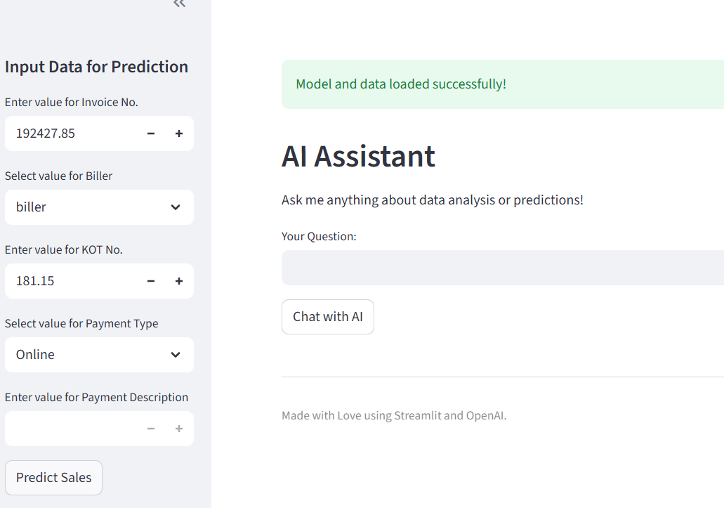

ML PIPELINE STAGE 4
Deployment: The Streamlit Web Application
User Input Sidebar
Integrated AI Chatbot
Instant Prediction
Intuitive interface allowing users to input the primary five features (e.g., date, marketing spend) to generate a forecast.
A powerful feature using the OpenAI API to allow users to query the underlying data and receive actionable business intelligence.
A single 'Predict' button quickly returns the forecasted Sales Value in ₹, supporting immediate decision-making.
A critical development step involved fixing a feature-mismatch error to ensure the inputs in app.py exactly matched the features the Linear Regression model was trained on.

Slide 9
OUTCOMES & PATH FORWARD
Results, Challenges, and Future Enhancements
Key Outcomes
Challenges Overcome
Future Enhancements
Successfully quantified and visualized sales patterns and customer behavior.
Tackled the initial complexity of the raw data structure and inconsistent formats.
Introduce more advanced models like XGBoost and ARIMA for greater accuracy.
Delivered an interactive, AI-driven dashboard that turns data into clear forecasts.
Handled missing data strategically across numerous features.
Automate dynamic reporting and visualization using Power BI dashboards.
Successfully managed the setup and configuration of the OpenAI API key integration.
Explore integrating a voice-based AI assistant for hands-free operational queries.

Slide 10
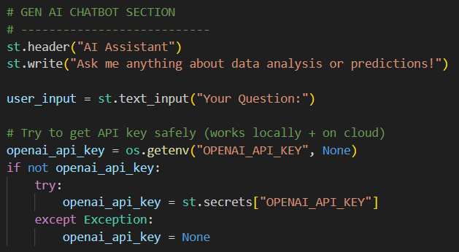
SUMMARY
Project Conclusion
This project demonstrates the successful creation of a full-stack, end-to-end ML and GenAI system tailored for Cloud Kitchen analytics.
Data-to-Insights
Accurate Prediction
From messy raw data to clean, actionable insights via rigorous EDA.
Trained an ML model providing reliable daily sales forecasts.
Operational Impact
Intelligent Support
Deployed a user-friendly application enabling smart, AI-driven business decisions.
Integrated a GenAI chatbot for conversational business intelligence.
“Turning kitchen data into business intelligence and operational advantage.”

